Slide 1
My Perimeter, Area and Volume Interactive Notebook
Name
Class
Term 3 Semester 2

Slide 2
Contents
Formula Page
Page
Date
Description
2
3

Slide 3
Tasks
24
7
30
Essential Question
Questions
Notes
Summary

Slide 4
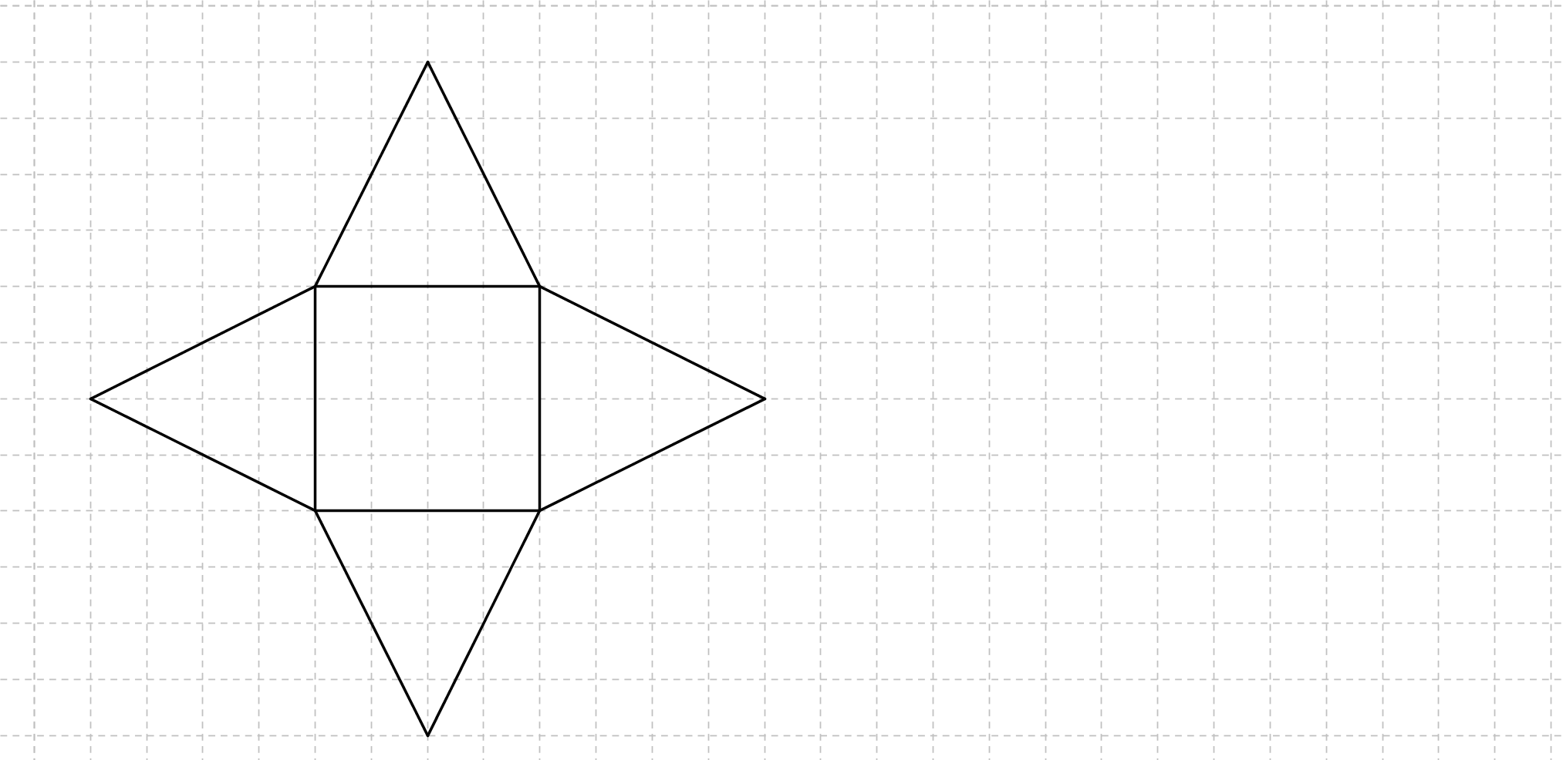
24
7
30
Date
Surface Area of a Pyramid
EQ – How is a net of a 3-D shape used to find the surface area of a pyramid?
TSA = Sum the area of all the faces

Slide 5

24
7
30
Date
Surface Area of a Pyramid
EQ – How is a net of a 3-D shape used to find the surface area of a pyramid?
TSA = Sum the area of all the faces
Square = 4 x 4 = 16
Triangle = $\frac{1}{2}×4×4=8$

Slide 6
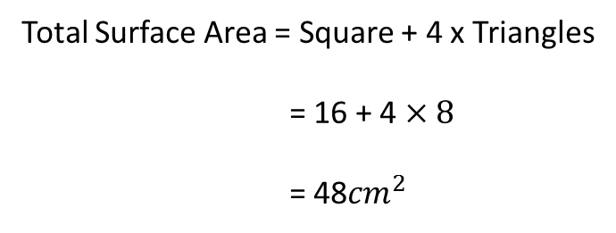
24
7
30
Date
Surface Area of a Pyramid
EQ – How is a net of a 3-D shape used to find the surface area of a pyramid?
TSA = Sum the area of all the faces
Square = 4 x 4 = 16
Triangle = $\frac{1}{2}×4×4=8$
Total Surface Area = Square + 4 x Triangles
= 16 + 4 $×8$
= 48${cm}^{2}$

Slide 7
Questions

Slide 8
Notes Review
24, 7 ,30
Date
Title
Essential question
Notes complete
Notes complete with colour and diagrams
Questions completed
Contents page filed in
Formula page filled in

Slide 9
Homework
Review your notes and write a summary answering the essential question.

Slide 10
Plenary
Draw three shapes with a perimeter of 36cm.

